Slide 1

Instagram user analytics (Project-2)
By: Akriti Panchbudhe

Slide 2
Instagram User Analytics
Project Description:
User analysis is the process by which we track how users engage and interact with our digital product (software or mobile application) in an attempt to derive business insights for marketing, product & development teams. These insights are then used by teams across the business to launch a new marketing campaign, decide on features to build for an app, track the success of the app by measuring user engagement and improve the experience altogether while helping the business grow. You are working with the product team of Instagram and the product manager has asked you to provide insights on the questions asked by the management team.

Slide 3
Approach
Identify all the tables I'll need in the query. Join tables containing the data you need to display or the data used in the WHERE part of the query. Display all data to check if I've joined everything correctly and to see the result of such a query.
Tech Stack Used
I only used the MYSQL Workbench to clean the data, there were no duplicates and other unknown values. I also created a relational schema and executed some SQL queries on the software to find insights.

Slide 4
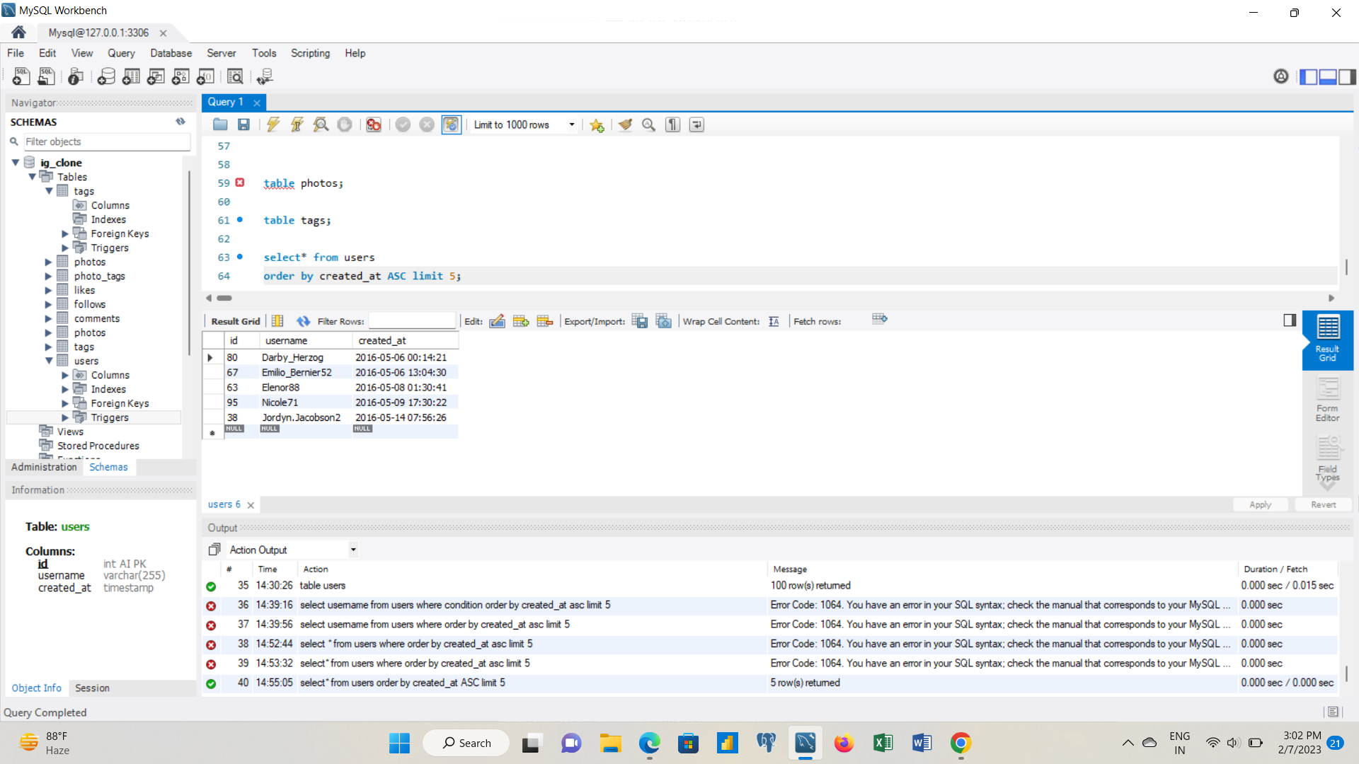
Insights
You are required to provide a detailed report answering the questions below :
A) Marketing: The marketing team wants to launch some campaigns, and they need your help with the following
1.Rewarding Most Loyal Users: People who have been using the platform for the longest time. Your Task: Find the 5 oldest users of the Instagram from the database provided
These are the 5 candidates who have been using the platform for the longest time.

Slide 5
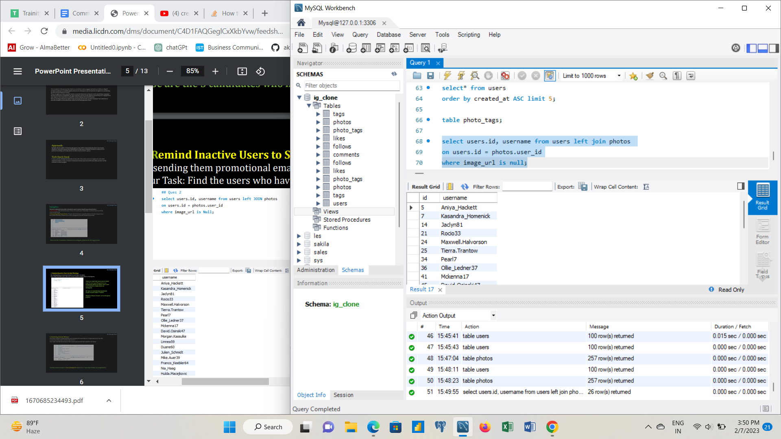
2. Remind Inactive Users to Start Posting: By sending them promotional emails to post their 1st photo. Your Task: Find the users who have never posted a single photo on Instagram.
There are total 100 users out of which only 74 users post the pictures on Instagram and 26 are those users who never posted a single photo on Instagram. We have to send them promotional emails to posts their 1st photo. Details of those 26 users are in the above picture.

Slide 6
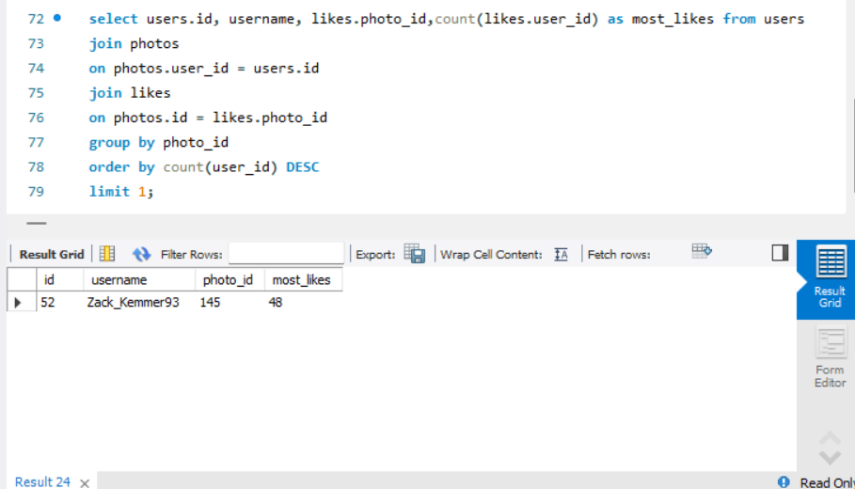
3. Declaring Contest Winner: The team started a contest and the user who gets the most likes on a single photo will win the contest now they wish to declare the winner.
Our Task: Identify the winner of the contest and provide their details to the team And the contest winner is Zack_Kemmer93 whose id is 52 gets the 48 likes on a single photo.

Slide 7
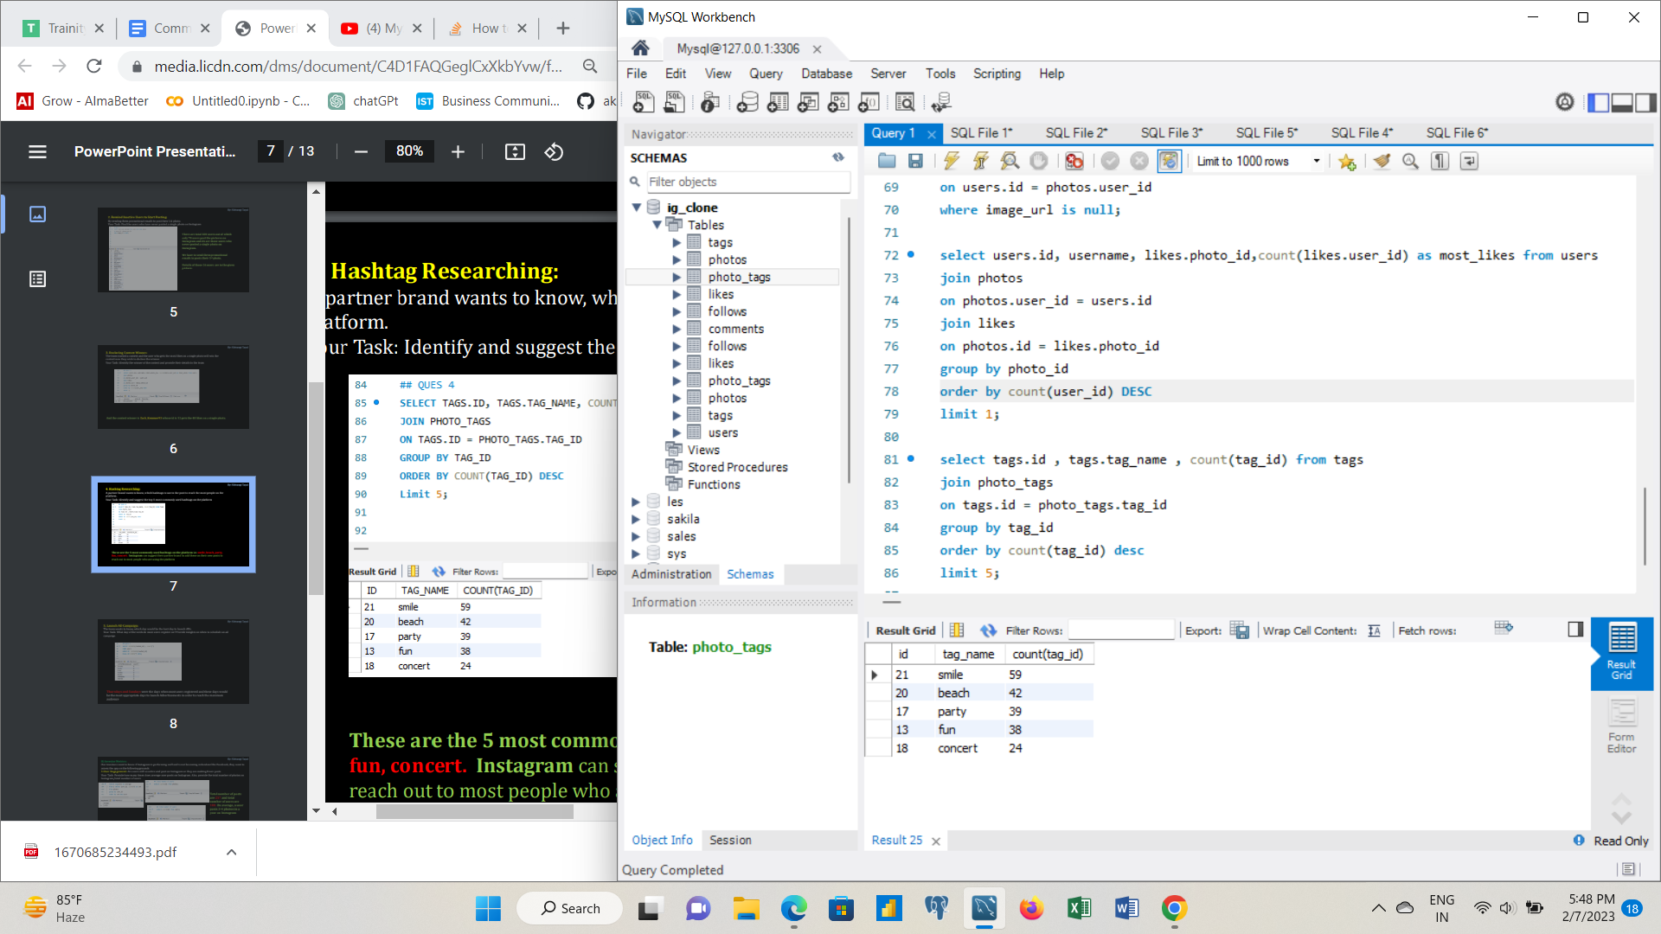
4. Hashtag Researching: A partner brand wants to know, which hashtags to use in the post to reach the most people on the platform. Your Task: Identify and suggest the top 5 most commonly used hashtags on the platform
These are the 5 most commonly used hashtags on the platform i.e. smile, beach, party, fun, concert. Instagram can suggest their partner brand to add these on their new posts to reach out to most people who are using the platform.

Slide 8
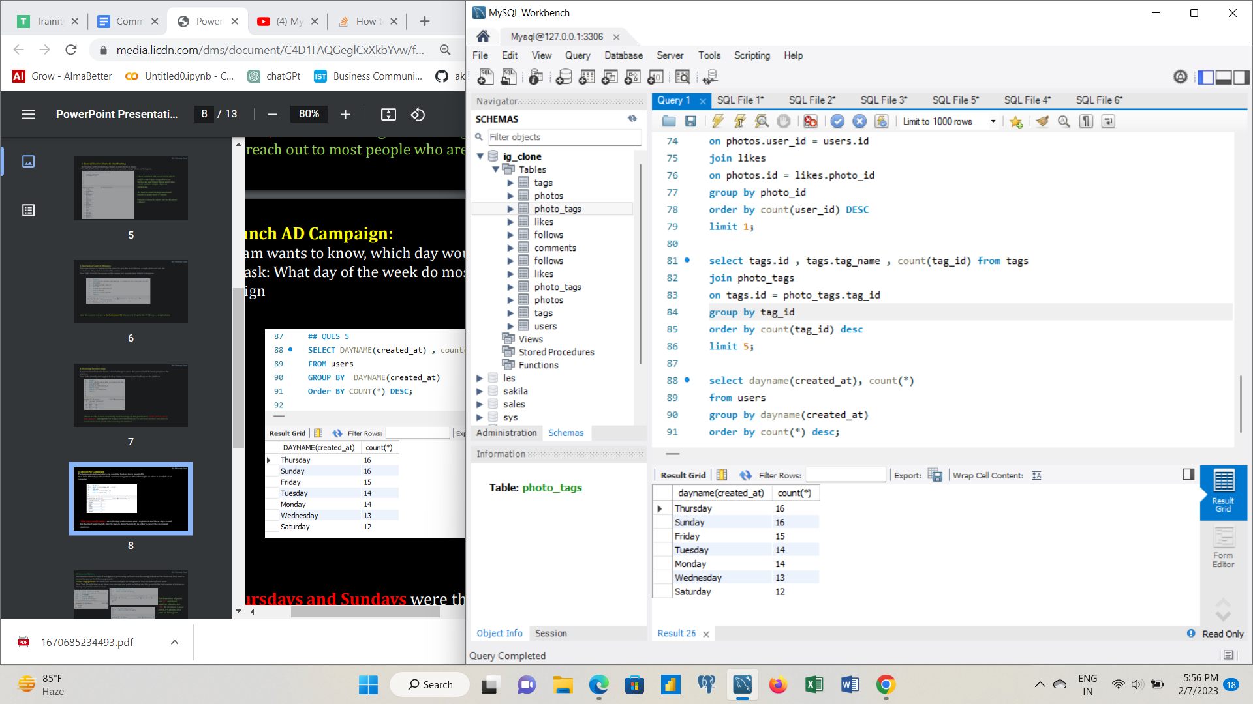
5. Launch AD Campaign: The team wants to know, which day would be the best day to launch ADs. Your Task: What day of the week do most users register on? Provide insights on when to schedule an ad campaign.
Thursdays and Sundays were the days when most users registered and these days would be the most appropriate days to launch Advertisements in order to reach the maximum audience

Slide 9
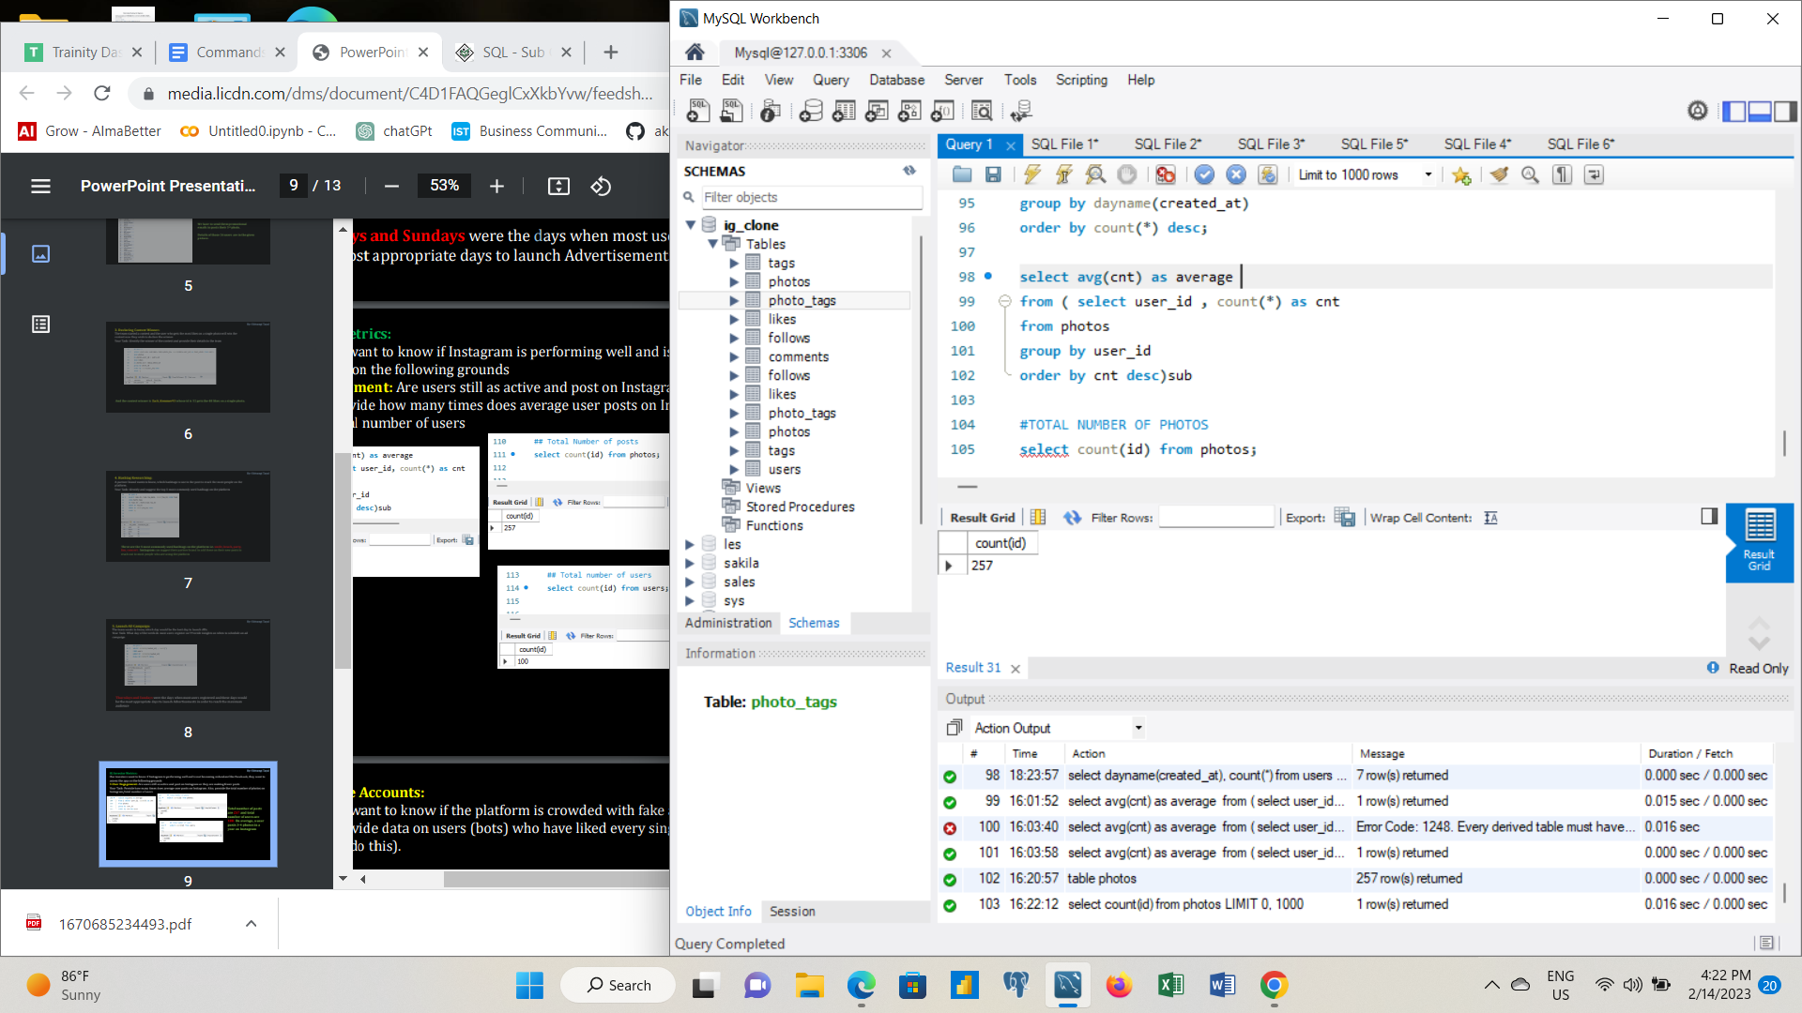
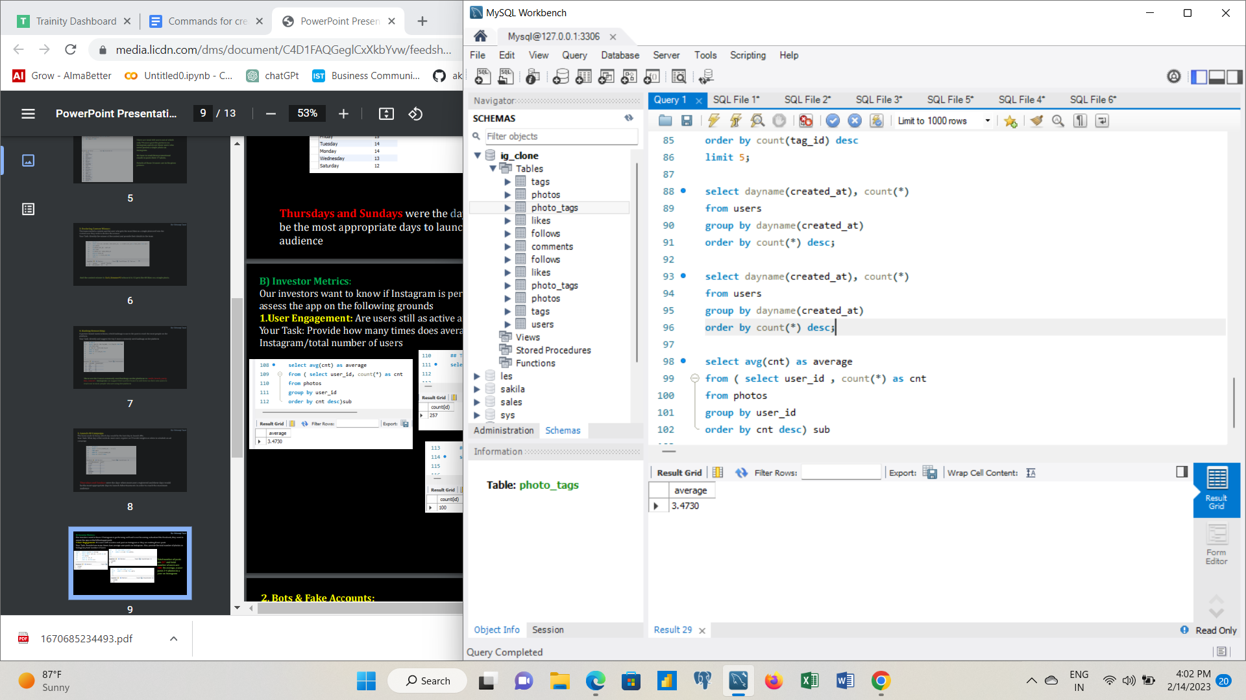
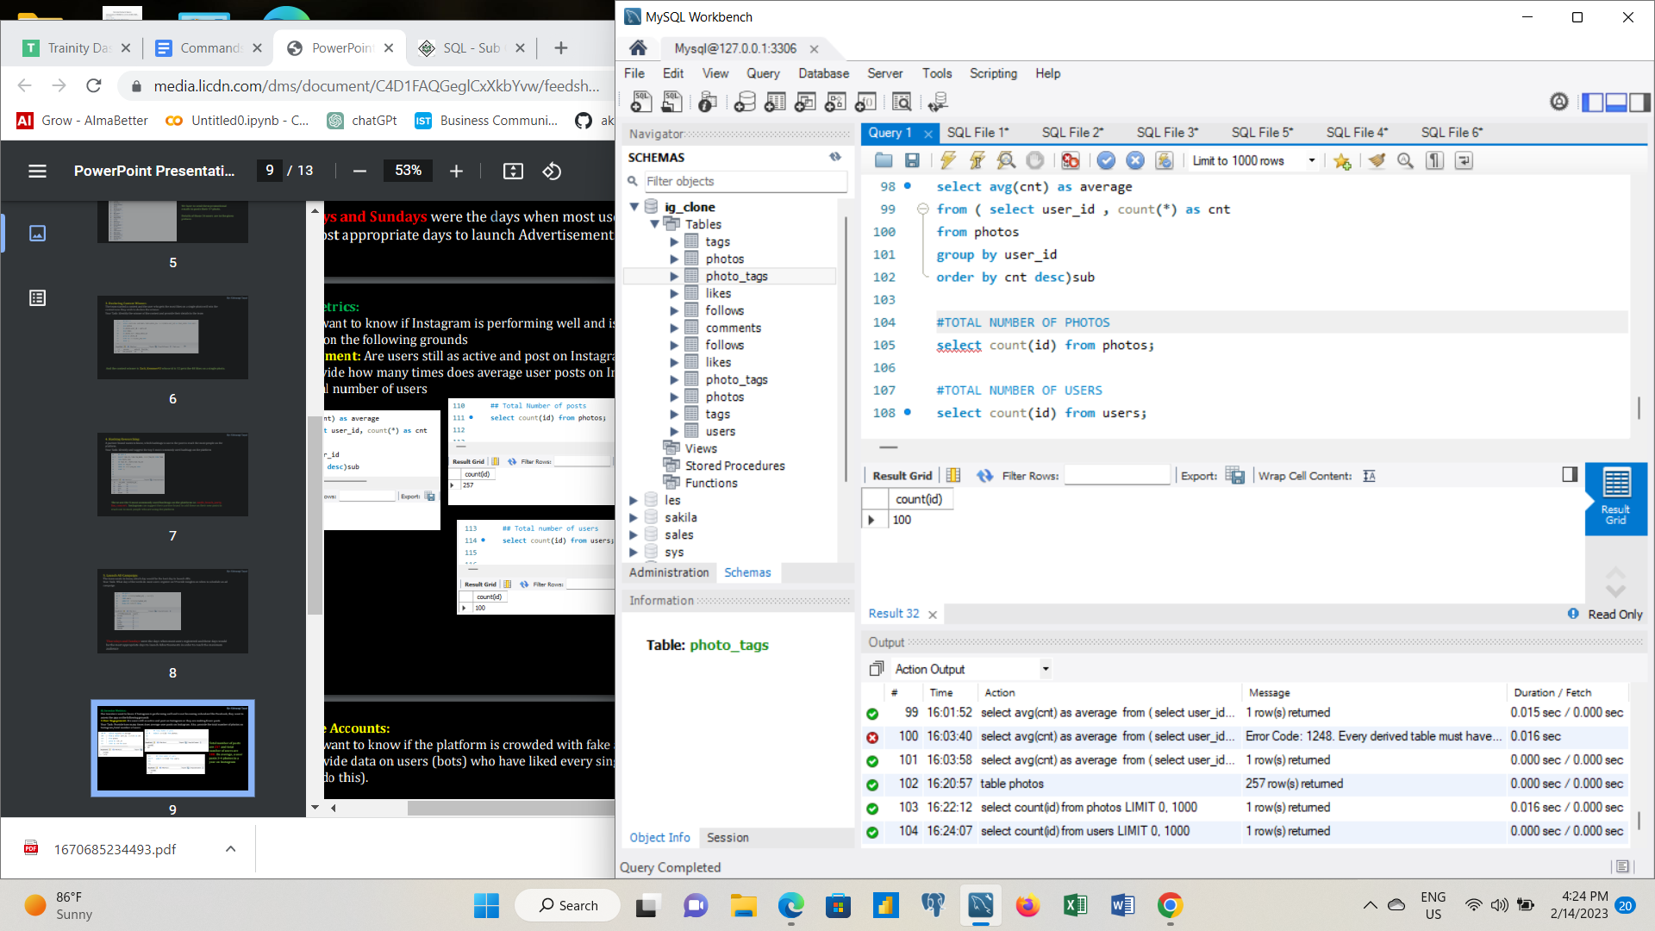
B) Investor Metrics: Our investors want to know if Instagram is performing well and is not becoming redundant like Facebook, they want to assess the app on the following grounds
1.User Engagement: Are users still as active and post on Instagram or they are making fewer posts Your Task: Provide how many times does average user posts on Instagram. Also, provide the total number of photos on Instagram/total number of users.
Total number of posts are 257 and total number of users are 100. On average, a user posts 3-4 photos in a year on Instagram.

Slide 10
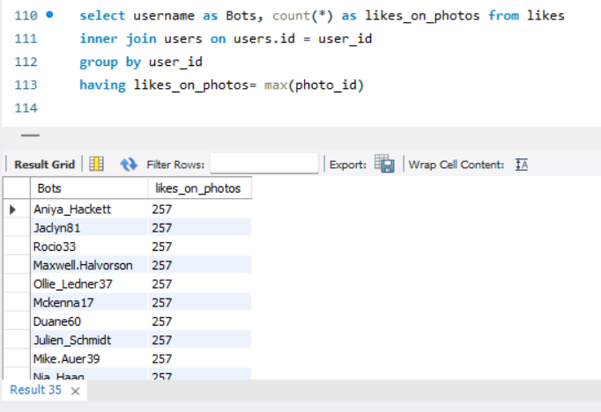
2. Bots & Fake Accounts: The investors want to know if the platform is crowded with fake and dummy accounts Your Task: Provide data on users (bots) who have liked every single photo on the site (since any normal user would not be able to do this).
There are 13 users who have liked every single photo posted on the site. Using the user id of these bots, they can be removed from the platform to make Instagram a spam free community.

Slide 11
Summary:
The top 5 oldest customers who are considered to be the most loyal ones created their accounts in the month of May. Darby was the first one to register .
There are 5 users who have never posted a single picture on Instagram as of yet.
The contest winner is Zack_Kemmer93 whose id is 52 gets the 48 likes on a single photo.
These are the 5 most commonly used hashtags on the platform i.e. smile, beach, party, fun, concert.
There are 13 bots on the platform that could fill the app with spam and irrelevant content.
It was found that Thursdays and Sundays were the days when most users registered.
On an average, a user was posting 3-4 photos in a year.

Slide 12
Result
SQL is one of the most crucial skills for anyone in a data driven position. It allows to draw information, build and analyse metrics efficiently. These insights helps us to find the most loyal customers, inactive users, commonly used hashtags, bots on the site. I learned that a lot of metrics other than the monetary ones could have a huge impact on the business decision making process.

Slide 13
Thank you

